Slide 1
Classification of Patients with Abnormal Blood Pressure

Slide 2
Objective
Employing statistical techniques, conduct a preliminary prognosis of Hypertension/hypotension, based on the level of hemoglobin and genetic history of the individual.

Slide 3
Approach Taken
Exploratory Data Analysis (EDA):
Identify the Data Distribution using following statistical methods:
Mean
Median
Identification of Outliers (if any) in Data.
Data Cleaning:
Identify the Columns having NULL values and replace it with more appropriate value.

Slide 4
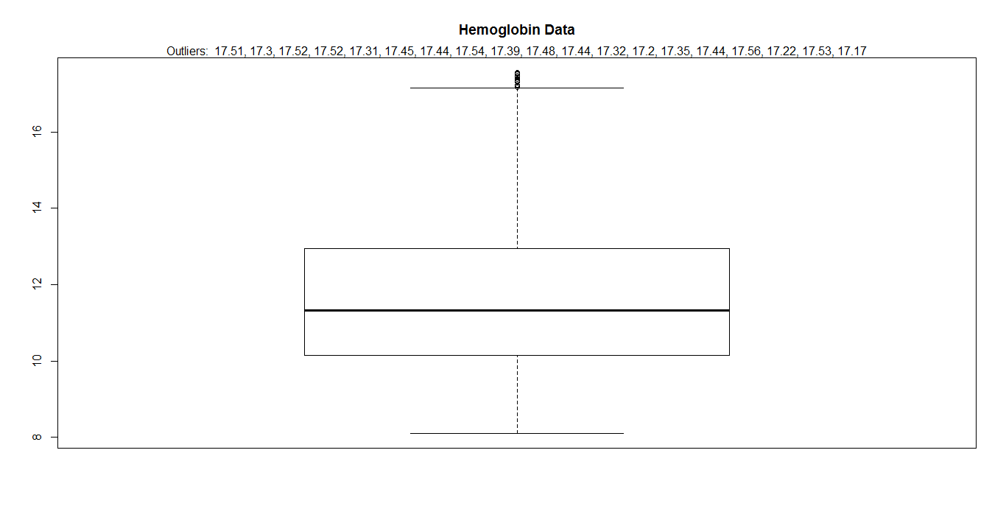
EDA – Box Plot Analysis Hemoglobin Data

Slide 5
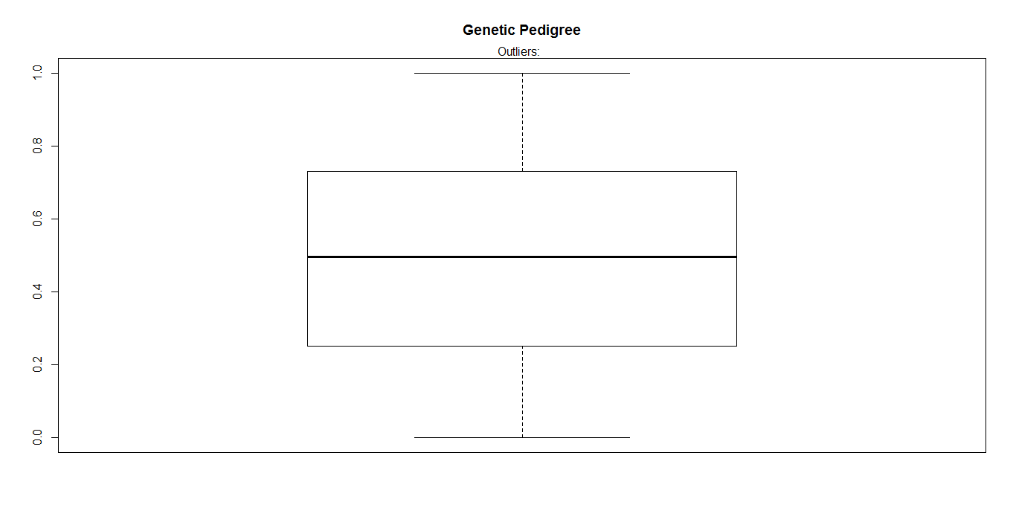
EDA – Box Plot Analysis Genetic Pedigree Data

Slide 6
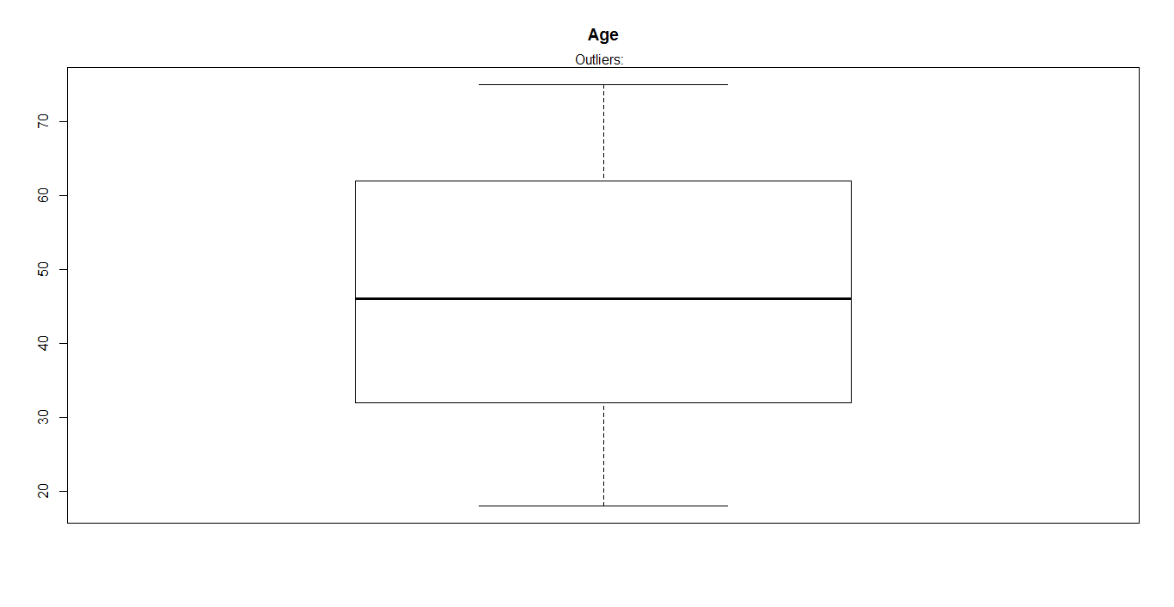
EDA – Box Plot Analysis Age Data

Slide 7
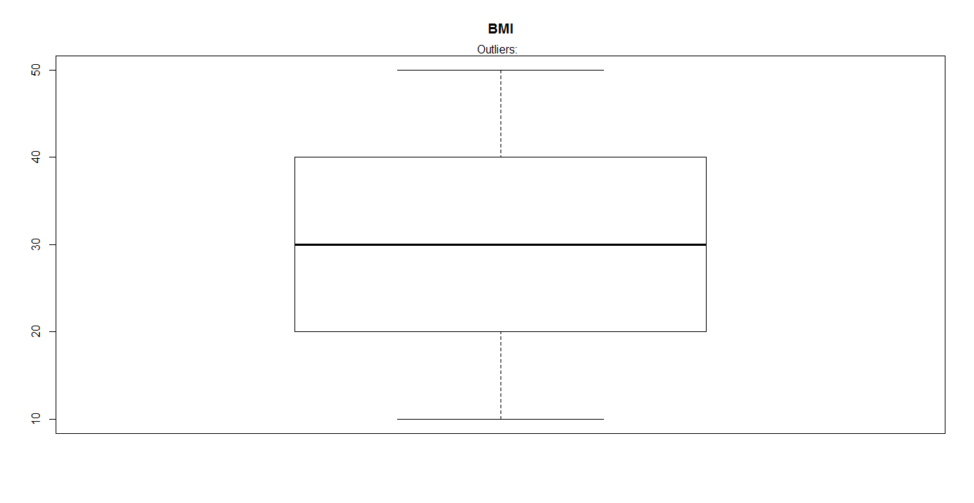
EDA – Box Plot Analysis BMI Data

Slide 8
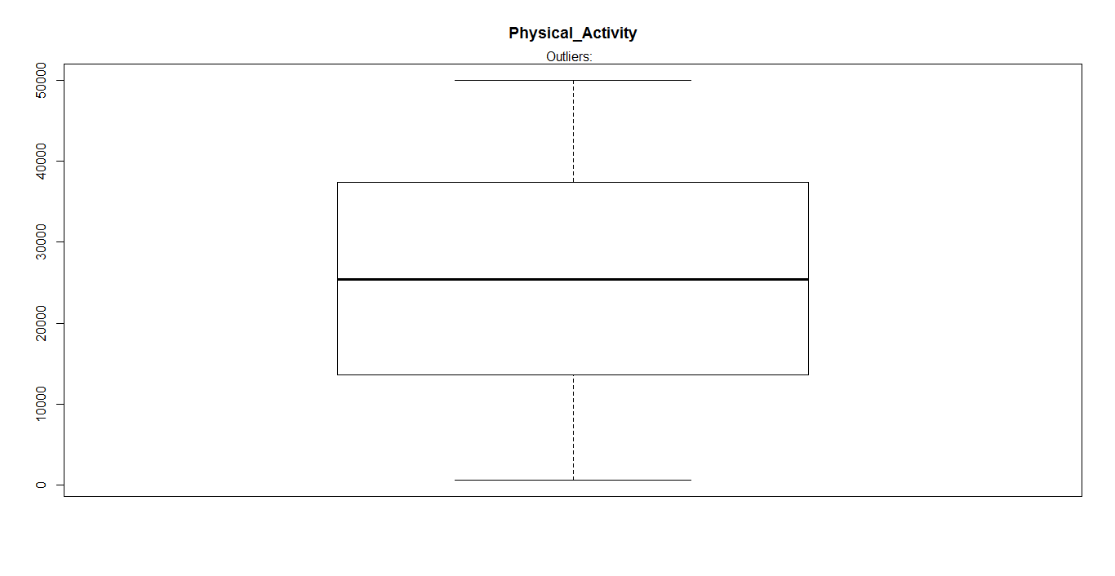
EDA – Box Plot Analysis Physical Activity Data

Slide 9
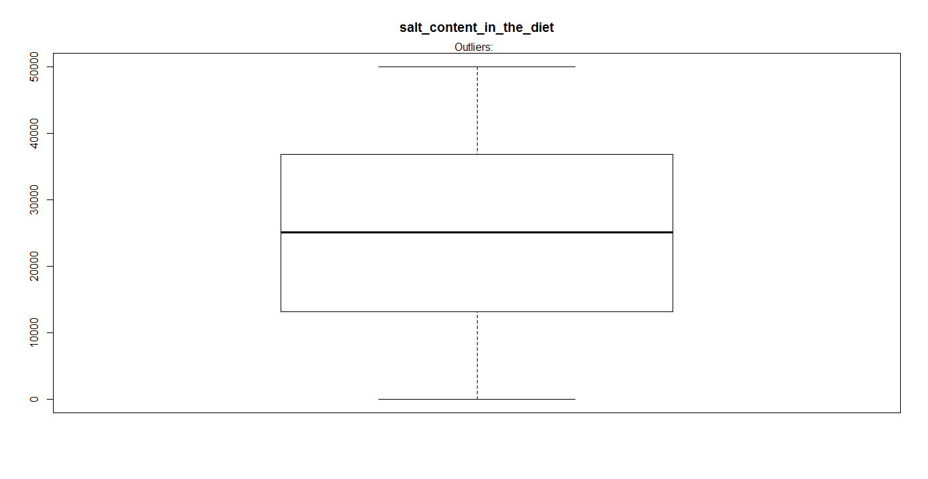
EDA – Box Plot Analysis Salt Content Data

Slide 10
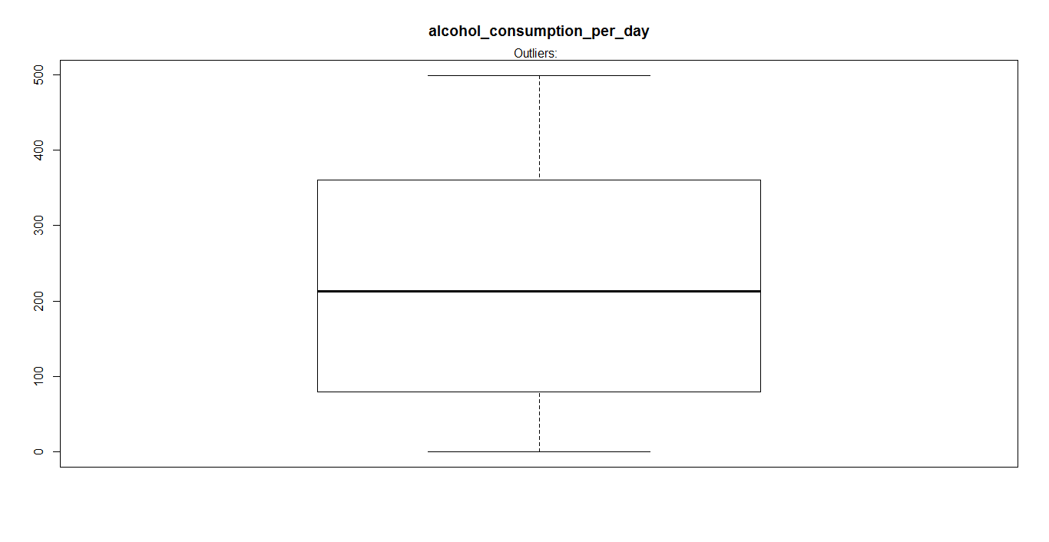
EDA – Box Plot Analysis Alcohol Consumption Data

Slide 11
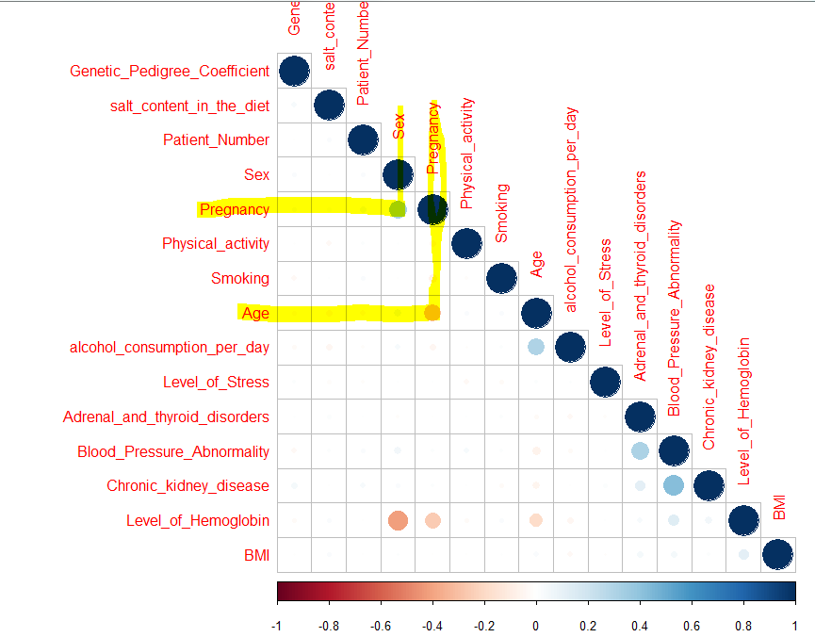
EDA: Column Relationship
The more dark Circle the
more is the
Strong Relationship

Slide 12
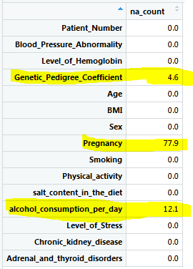
Data Cleaning NULL Value Percentage in Initial Data

Slide 13
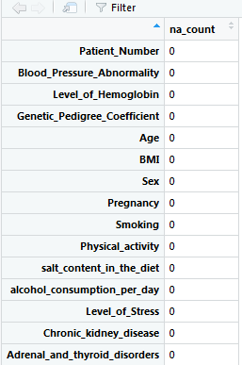
Data Cleaning After Data Cleaning

Slide 14
Model Accuracy
Model Name | 2 Variables | All Variables
Decision Tree | 91.01 | 89.18
SVM | 92.51 | 83.36
Random Forest | 90.18 | 84.19
Logistic Regression | 61.68 | 73.69
Naïve Baye's | 84.02 | 82.69
2 Variables = Hemoglobin and Genetic Pedigree Coefficient
All Variables = Hemoglobin and Genetic Pedigree Coefficient,
Smoking, obesity (BMI), Lack of physical activity,
salt content in the diet, alcohol consumption per day, Level of Stress, Age, Sex,
Pregnancy, Chronic kidney disease and Adrenal & thyroid disorders.

Slide 15
Summary
With the above 2 approach taken, it has been observed Decision Tree Model is giving the best Accuracy.

